Slide 1

Building Resilient Multi-Agent System with LangGraph: Lessons from Production
LangGraph로 죽지 않는 멀티 에이전트 만들기: 실전 에이전트 생존기
오성우

Slide 2
Speaker
오성우 Sungwoo Oh
링크드인 linked.in/sackoh
깃헙 github.com/sackoh
LangCon 2024 - 당신의 인공지능 저작권은 안녕하십니까?
PyCon Korea 2023 - 로컬 환경에서 사이즈가 큰 데이터를 효과적으로 처리/분석하기 위한 전략
PyCon Korea 2020 - 금융 언어 이해를 위해 개발한 ALBERT 톺아보기
PyCon Korea 2019 - 뚱뚱하고 굼뜬 판다(Pandas)를 위한 효과적인 다이어트 전략
오픈소스와 공유의 힘을 믿습니다.

Slide 3
Contents
Introduction
The Stacks of AI Agent System
Why We Chose LangGraph
What Changed in LangGraph 1.0
Building Resilient Multi-Agent
① LLMs - Multiple sources by design
② Context - Feeding the right context
③ Orchestration - Where LangGraph shines
④ Observability - Can’t fix what you can’t see
Conclusion
4
13
17
23
31
32
39
54
62
71

Slide 4

Do we really need a framework for agents? 🤔

Slide 5
Do we really need a framework for agents? 🤔
❶ Introduction
LLM ecosystem today
Dozens of orchestration frameworks
New “agent platforms” every month
But many experts say:
“Just start with the raw API”
“Frameworks are optional, not mandatory”

Slide 6
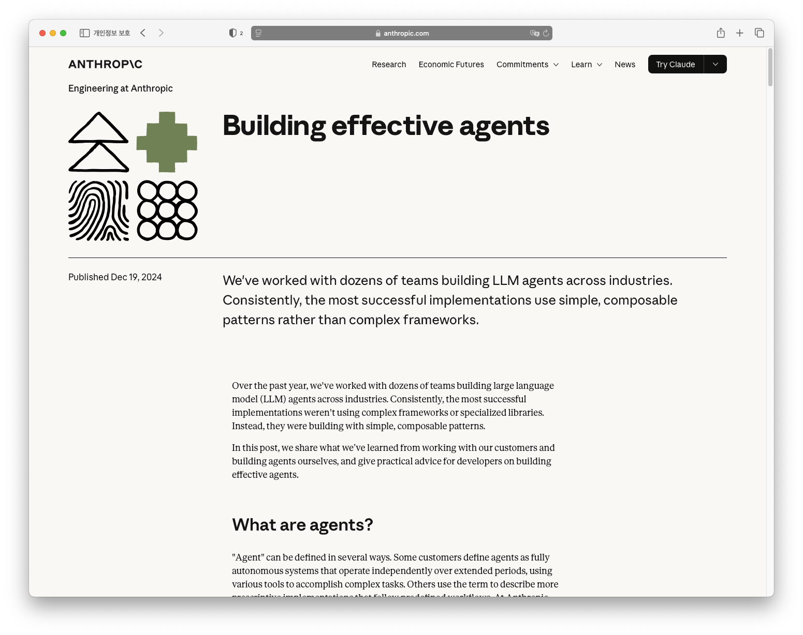
Anthropic: “Start simple. Use direct API calls first”
❶ Introduction
Suggested Approach
Begin with basic loops or scripts
Use raw outputs (JSON / tool responses) directly) Avoid unnecessary abstraction early on
Measure what actually hurts
Only then consider a framework
Core idea:
Simple first, complexity layer
Frameworks are optional, not a prerequisite
Sources: https://www.anthropic.com/engineering/building-effective-agents

Slide 7
Anthropic: “Start simple. Use direct API calls first”
❶ Introduction
“Over the past year, we've worked with dozens of teams building large language model (LLM) agents across industries. Consistently, the most successful implementations weren't using complex frameworks or specialized libraries. Instead, they were building with simple, composable patterns.”
...
“We suggest that developers start by using LLM APIs directly: many patterns can be implemented in a few lines of code. If you do use a framework, ensure you understand the underlying code. Incorrect assumptions about what's under the hood are a common source of customer error.”
Sources: https://www.anthropic.com/engineering/building-effective-agents

Slide 8
Other voices: Karpathy, Hamel, …
❶ Introduction
Andrej Karpathy
“LLM apps = prompt + loop + tools”
Prefer transparent, debuggable code early on
Hamel Husain & Others
Ship v0 with minimal orchestration
Focus on logging, prompts, evals > fancy graphs
Shared message:
Don’t start with heavy abstractions
Own the control flow yourself first
Add frameworks only when pain is proven

Slide 9
Framework? Just use raw Python code…
❶ Introduction
Common anti-abstraction claims
“Why use LangGraph? Just write a few lines of Python on top of the LLM API.”
“More abstraction → less control”
“We’ll get locked into the framework”
These concerns are reasonable
Let’s apply the same logic somewhere else…

Slide 10
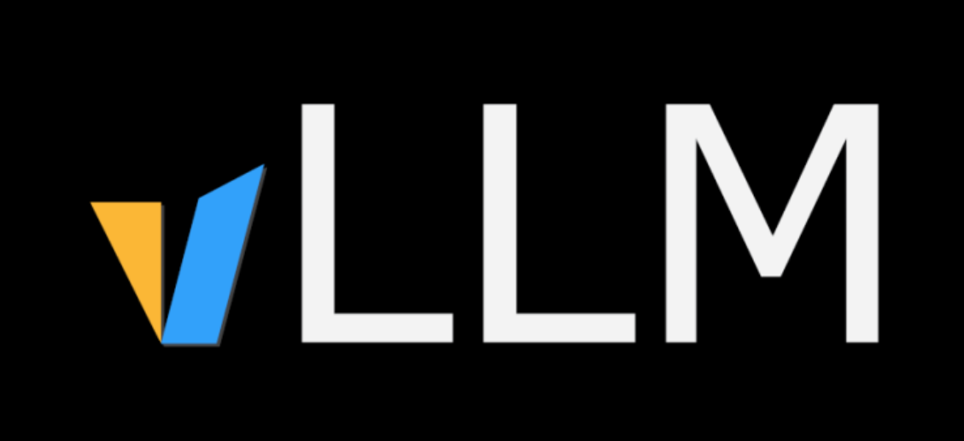
Why we don’t hand-roll LLM serving?
❶ Introduction
We use vLLM not because we’re incapable
We use it because we can’t spend all our time on:
KV cache, batching, scheduling
Glud code for every new open-source model
Model rollout / rollback
Monitoring, logging, autoscaling
We delegate infra complexity to a serving framework
This let us focus on:
“What should we serve to users?”
Not “How do we reinvent a serving stack?”

Slide 11
Same logics can apply to Agent Framework
❶ Introduction
Agent systems have their own “infra”:
Multi-agent orchestration
State management & checkpoints
Retry, pause/resume
HITL, tool calling, long-running workflows
Observability, debugging, testing, deployment
Saying “we’ll code all of this from scratch” is like saying:
“Don’t use vLLM, build your entire serving stack yourself.”
Where do we want to spend our limited engineering time?
Frameworks don’t remove control
They let us delegate low-leverage complexity so we can focus on product & value

Slide 12
Small Teams: Not Desperate, Strategic
❶ Introduction
👤 Common narrative:
“We’re a small team, we have no choice but to use frameworks.”
📍 My claim:
Small teams are not making desperate choices
They are making strategic choices
Key questions:
With limited people & time
Where do we intentionally invest our engineering effort?
What do we consciously delegate to a framework?

Slide 13
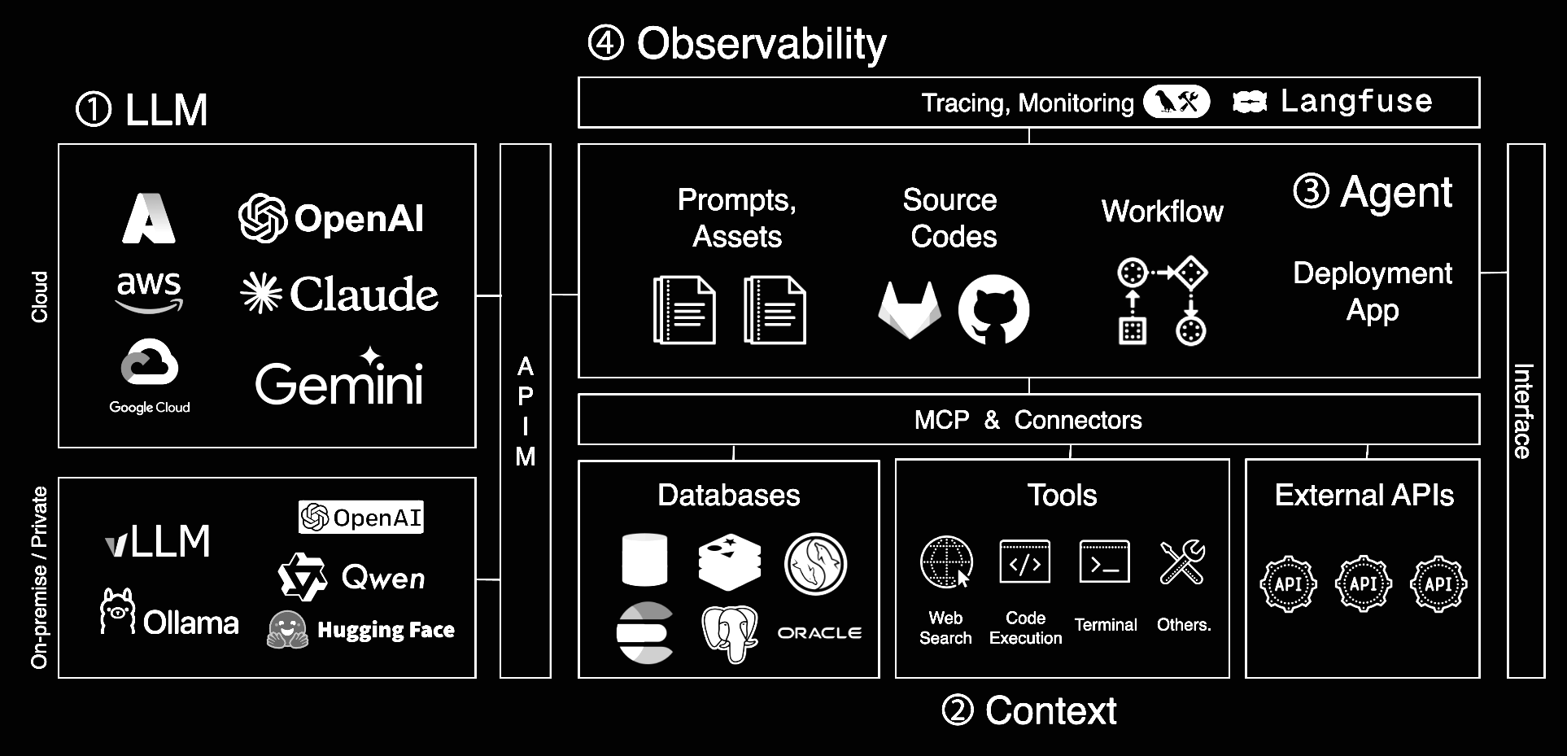
The Stacks of Agent System
❷ The Stack of Agent
④ Observability
① LLM
③ Agent
② Context

Slide 14
The Stack of Doom for Small Agent Teams ☠️
❷ The Stack of Agent
Prompt & Agent Design
Per-agent / per-model prompt tuning
System prompts, roles, tools schema
Workflow & Orchestration
Complex branching logic
State management across steps
Error handling & retries
RAG & Data Layer
Vector DB / indices
Retrieval quality, ranking
Data refresh & governance
Tooling & Integration
MCP servers / tool APIs
Internal microservices as tools
Auth, rate limits, quotas
Ops & Platform
Deployment, CI/CD
Monitoring, logging, tracing
Cost & quota management

Slide 15

3-4 Engineers, 3 Months: What’s Realistic?

Slide 16
3-4 Engineers, 3 Months: What’s Realistic?
❷ The Stack of Agent
Small-team reality check 🧮
Team size: 3-4 engineers
TImeline: ~3 months to MVP/launch
Key questions:
Can we implement the entire Stack of Doom in raw Python?
Can we reliably maintain it as requirements & models change?
Can we handle prod incidents, regressions, and feature requests on top?
Strategic view:
Using frameworks is not a sign of weakness
Concentrating effort on differentiating layers
Delegating generic plumbing to a runtime/framework → With this in mind, let’s see where LangGraph fits into this stack.

Slide 17
Why we chose LangGraph (Not settled for it)
❸ Why LangGraph
Strategic lens for LangGraph
1️⃣ Business - Focus on what the agent does
2️⃣ Financial - Custom agents can be cheaper
3️⃣ Ops - Agents must be safe and resilient
Not “we’re small, we have no choice”
But: “Given our constraints, what’s the smartest stack?”

Slide 18
Business First: What should the agent actually do?
❸ Why LangGraph
Business-first mindset 💼
Less: “How do we implement multi-agent orchestration?”
More: “what exact workflow should this agent execute?”
With LangGraph, we could spend more time on
Task decomposition & domain logic
UX of failure / clarification / handoff
Guardrails aligned with business rules
The framework handled
Wiring between nodes
State passing, retries, branching → We optimized for user value, not graph plumbing

Slide 19
Costs Matter: When custom agents are actually cheaper
❸ Why LangGraph
General-purpose agents are convenient… but 💸
Claude Code, generic “do-everything” agents
Great DX, but:
Longer reasoning chains
Morel tool calls & loops
Unpredictable token usage
Custom agent on LangGraph:
Narrow, task-specific flows
Hard limits on: depth of reasoning, number of tool invocations
Predictable + lower per-run cost
Trade off:
Higher dev cost upfront, but Lower operational cost at scale → For us, custom agents were the cheaper choice over time

Slide 20
Ops view: Agents that don’t die or go rogue
❸ Why LangGraph
Ops reality: shipping =! done 🚨
Real work starts after deployment
We care about
Not just “does it run?”
BUt “does it recover?” and “does it avoid bad actions?”
Operational needs for agents
State & checkpointing
Automatic retries & backoff
Pause / resume long-running workflows
Safe rollbacks on failures
LangGraph gave us A runtime build around these features and hooks for observability
→ This made “don’t die, don’t go rogue” a design property, not an afterthought

Slide 21
Recap: LangGraph as a Strategic Bet
❸ Why LangGraph
Using an agent framework like LangGraph is
We want to optimize across…
Business - focus on behavior & value
Finance - control run-time cost with custom flows
Ops - build agents that don’t die or go rogue
Lang Graph act as a
Controlled runtime for multi-agent workflows
Platform for survivability features (state, retries, HITL)
→ A strategic decision balancing product, cost, and reliability

Slide 22
Designing “Die Hard” multi-agent with LangGraph
This talk is not
A LangGraph 101 tutorial
A feature-by-feature walkthrough
This talk is
A field report on designing resilient multi-agent systems
On top of LangGraph, in real production environments

Slide 23
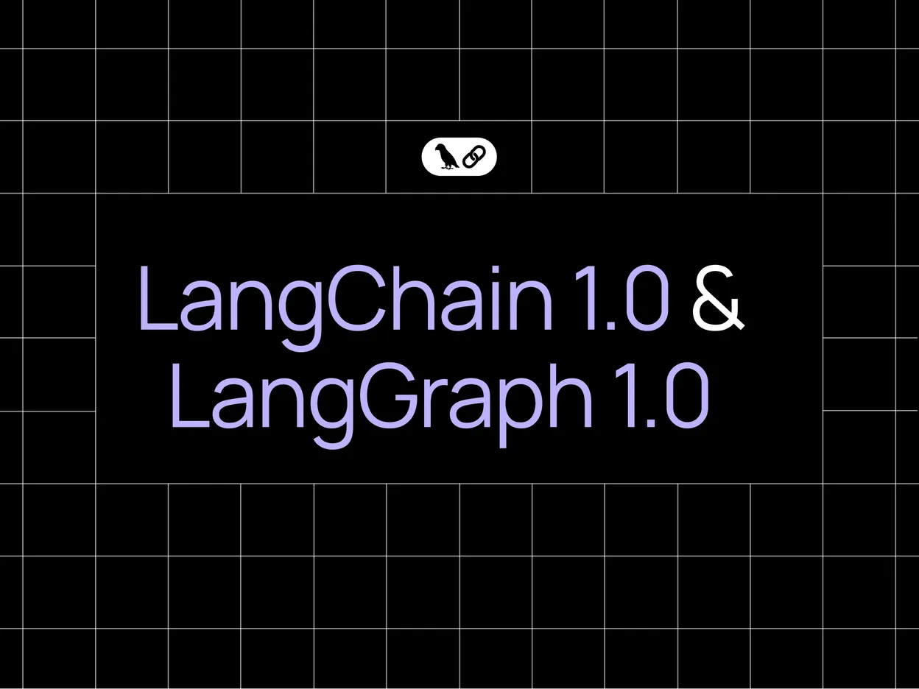
LangChain & LangGraph Agent Frameworks Reach v1.0
❹ LangGraph 1.0
Sources: https://blog.langchain.com/langchain-langgraph-1dot0/

Slide 24
LangGraph 1.0: Perfect Timing
❹ LangGraph 1.0
Timing ⏲️
While mapping our “Stack of Doom”
LangGraph 1.0 was officially released
This raised a key question:
“Is this still a demo tool?”
Or “is this ready for production?”

Slide 25
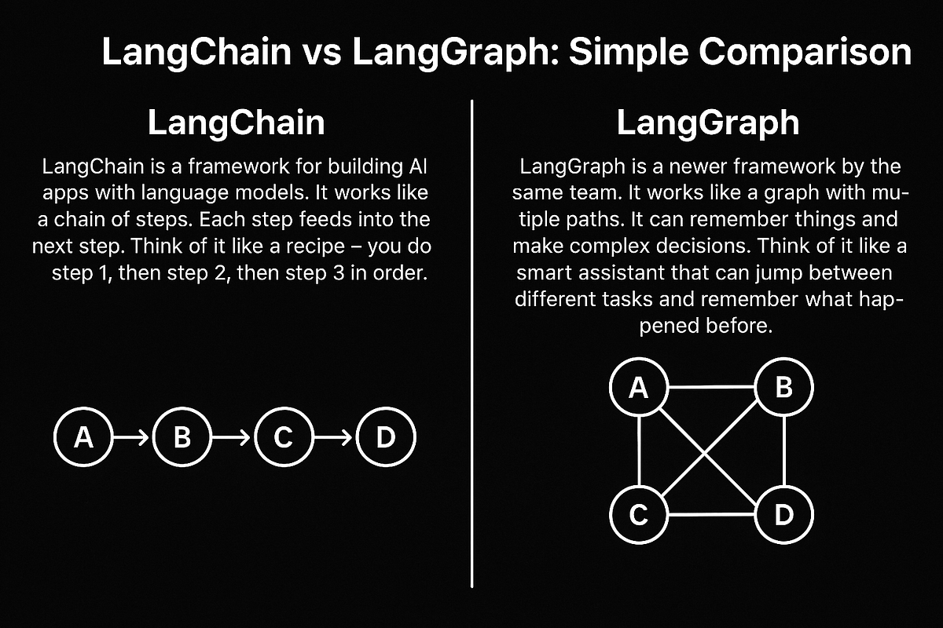
LangChain vs LangGraph: Who does What?
❹ LangGraph 1.0
Use LangChain to shape the agent, Use LangGraph to keep the agent alive
Framework | Details
LangChain | Linear flow Built on top of LangGraph Standard agent patterns Tool calling & model wrappers Great for: “build something quickly”
LangGraph | Graph-based flow State-based graph runtime Long-running workflows Checkpoints, interrupt/resume Multi/hierarchical agent orchestration
Sources: https://medium.com/data-science-collective/langchain-vs-langgraph-simple-comparison-9798d8c8a95c

Slide 26
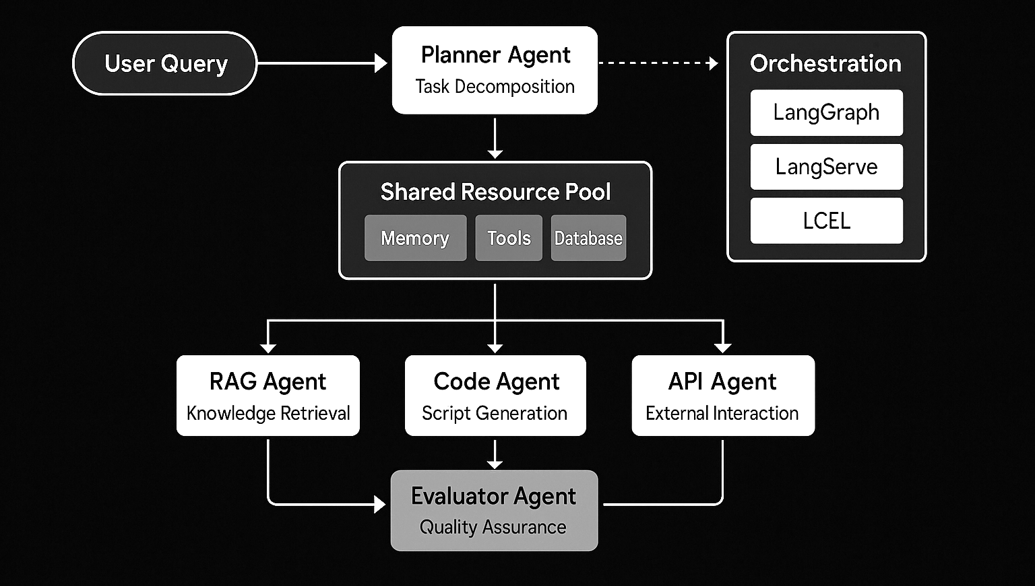
Example: LangChain Multi-Agent Workflow
❹ LangGraph 1.0
Sources: https://www.infoservices.com/blogs/artificial-intelligence/langchain-multi-agent-ai-framework-2025

Slide 27
LangGraph 1.0: From Toy to Real Runtime
❹ LangGraph 1.0
v1.0 felt like a phase shift
From: “Cool research / demo tool”
To: “Potential production runtime”
Why it mattered to us
Stability for long-running workflows
Durable (parallel) execution + checkpointing
Practical interrupt / resume
Tight integration with LangChain & LangSmith + other Lang-ecosystem
“Can we run production on this?”

Slide 28
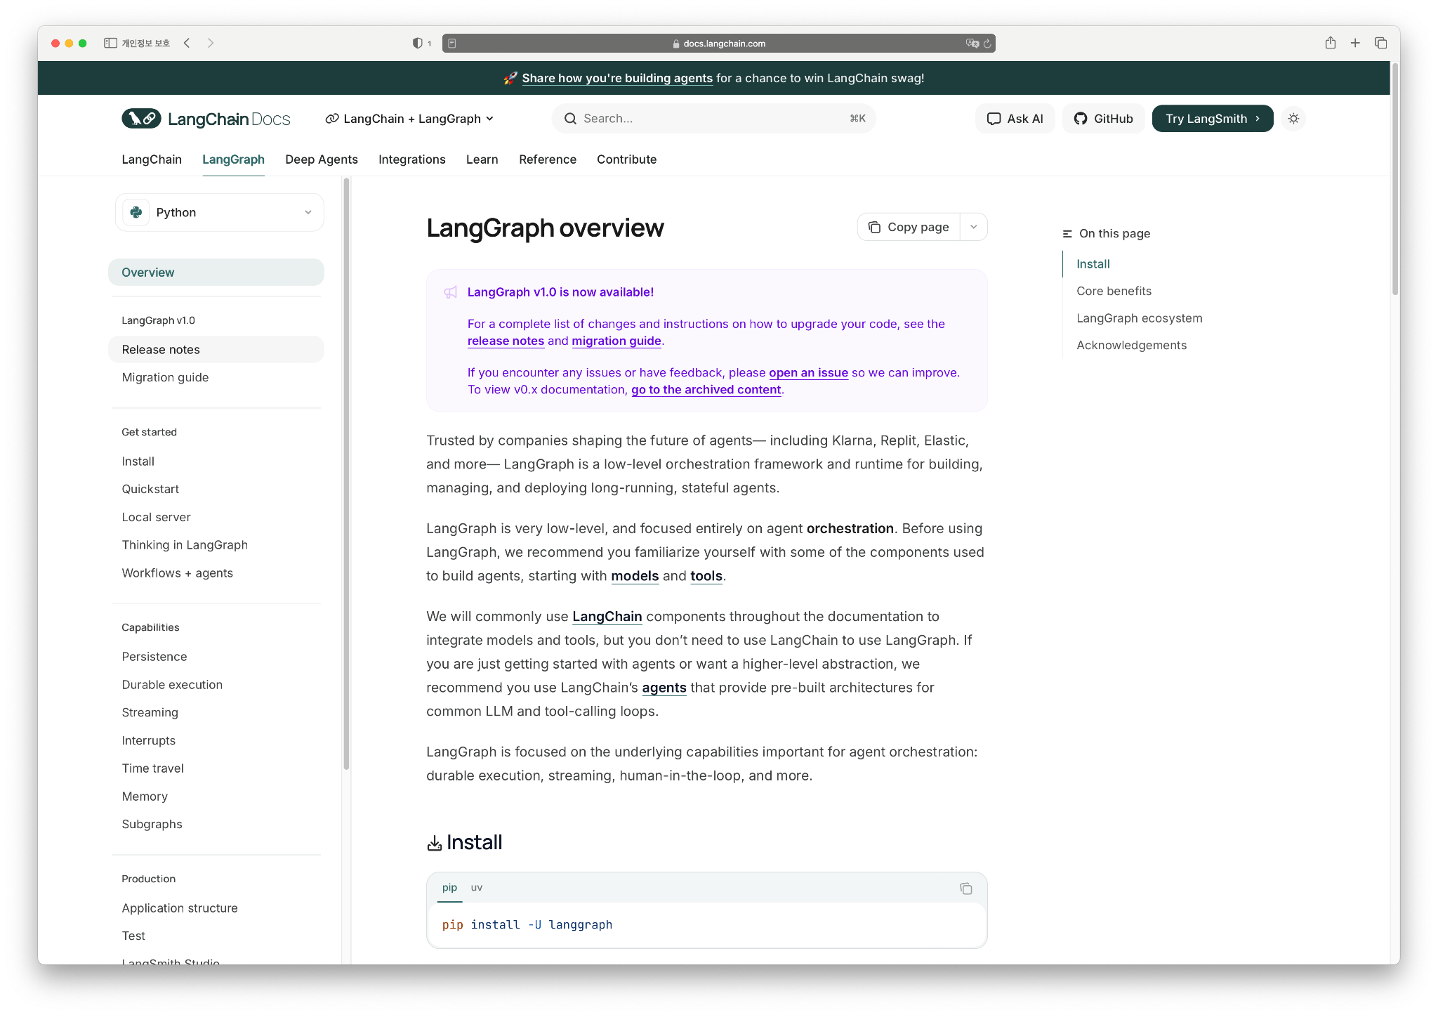
What changed in 1.0
❹ LangGraph 1.0
Sources: https://docs.langchain.com/oss/python/langgraph/overview

Slide 29
What changed in 1.0 (That we actually care about)
❹ LangGraph 1.0
Key aspects we cared about in 1.0 ✅
Long-running workflow stability
Durable execution & checkpoints
Interrupt / resume at practical level
Full integration with 🦜⛓️LangChain Runnables
🪢 Langfuse integration (+ LangSmith) for observability
Self-hosted agent deployment
More “real orchestration engine for prod”

Slide 30
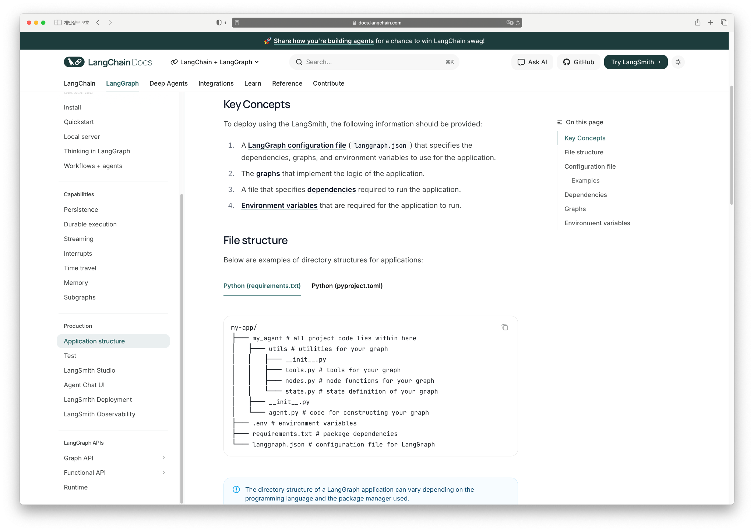
LangGraph Application Structure
❹ LangGraph 1.0
📌
Sources: https://docs.langchain.com/oss/python/langgraph/overview

Slide 31

For “Die Hard” Agent System
① LLMs - Multiple sources by design
② Context - Feeding the right context
③ Orchestration - Where LangGraph shines
④ Observability - Can’t fix what you can’t see

Slide 32
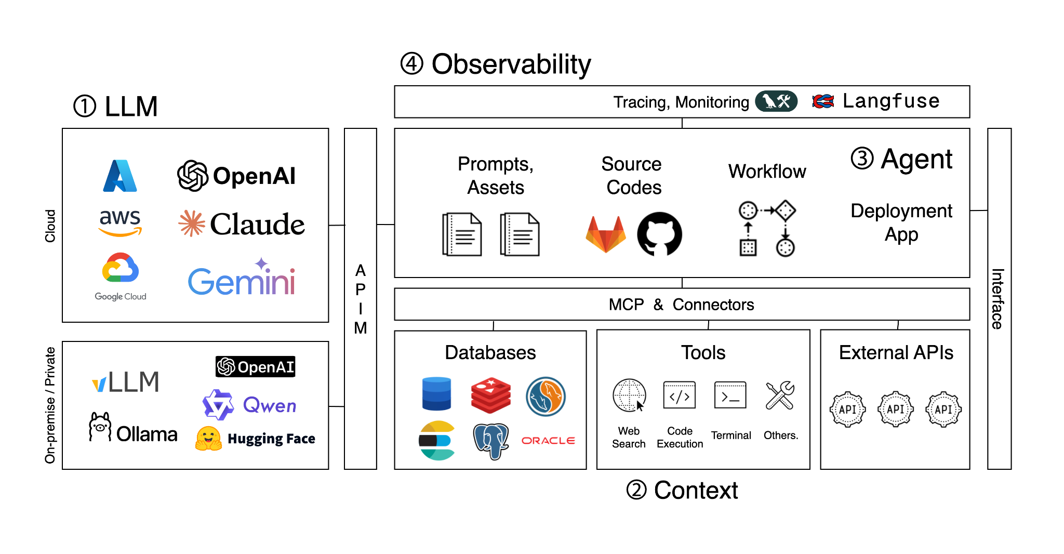
The Stacks of Agent System - ① LLMs
❺ Strategy for Resilient Agent
Copied

Slide 33
① LLMs - Multiple sources by design
❺ Strategy for Resilient Agent
Cloud providers, or LLM Providers
Azure + OpenAI
AWS Bedrock + Claude
GCP Vertex AI + Gemini
On-prem OSS serving
E.g., gpt-oss-120b, Qwen3, …
Local / fine-tuned models
Task-specific fine-tuned small LLMs
Assumption: Agents will route across heterogeneous LLM backends

Slide 34
The real issue behind multi-model strategy
❺ Strategy for Resilient Agent
Our LLM question was not
“How can we use many models?”
Our real question was
“How do we make sure the system doesn’t die when one model dies?”
“How can we shift the model for the recent model without any workflow code changes?”
Multi-model reality:
Azure OpenAI, AWS Bedrock, GCP Gemini
On-prem OSS
Local fine-tuned LLMs
Goal: Swap / fail models without taking the graph down

Slide 35
Why we didn’t hand-code every provider?
❺ Strategy for Resilient Agent
Why not implement per-model logic?
Different SDKs
Different parameters
Different error types
→ Managing all of this per-agent = 💀
Approach
Wrap everything behind LangChain’s BaseChatModel
Serve OSS via vLLM OpenAI-compatible API
→ Swapping models = config change, not code surgery

Slide 36
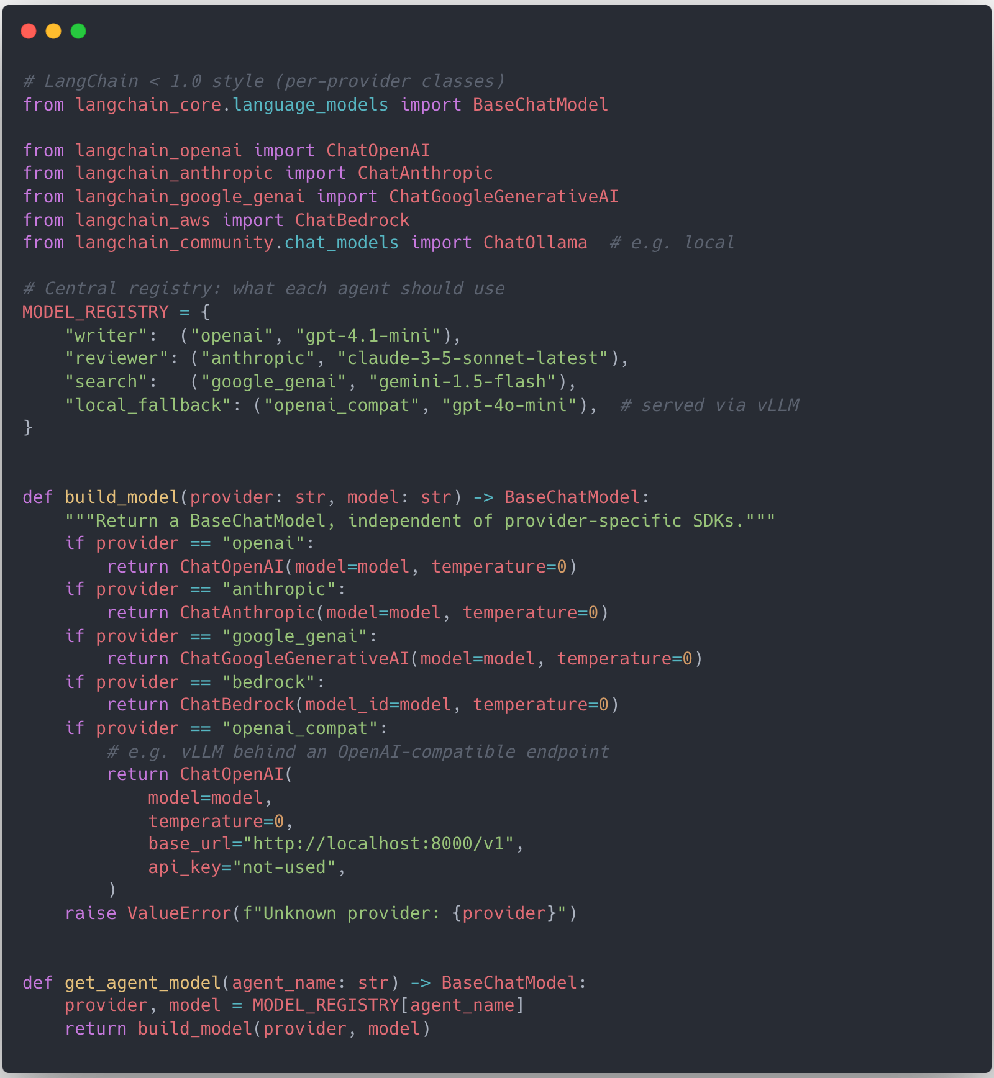
In Code: Unifying Models with BaseChatModel
❺ Strategy for Resilient Agent
LangChain < 1.0
Sample
Overview
Hide provider differences behind BaseChatModel
Each provider still needs its own class & params
vLLM / OSS is exposed vi OpenAI-compatible HTTP API
Initialize LLM instance via get_agent_model
Single graph node type can now depend on single BaseChatModel interface
Swapping models = editing MODEL_REGISTRY, not touching graph code
→ but still need to manually keep imports & provider-specific params in sync

Slide 37
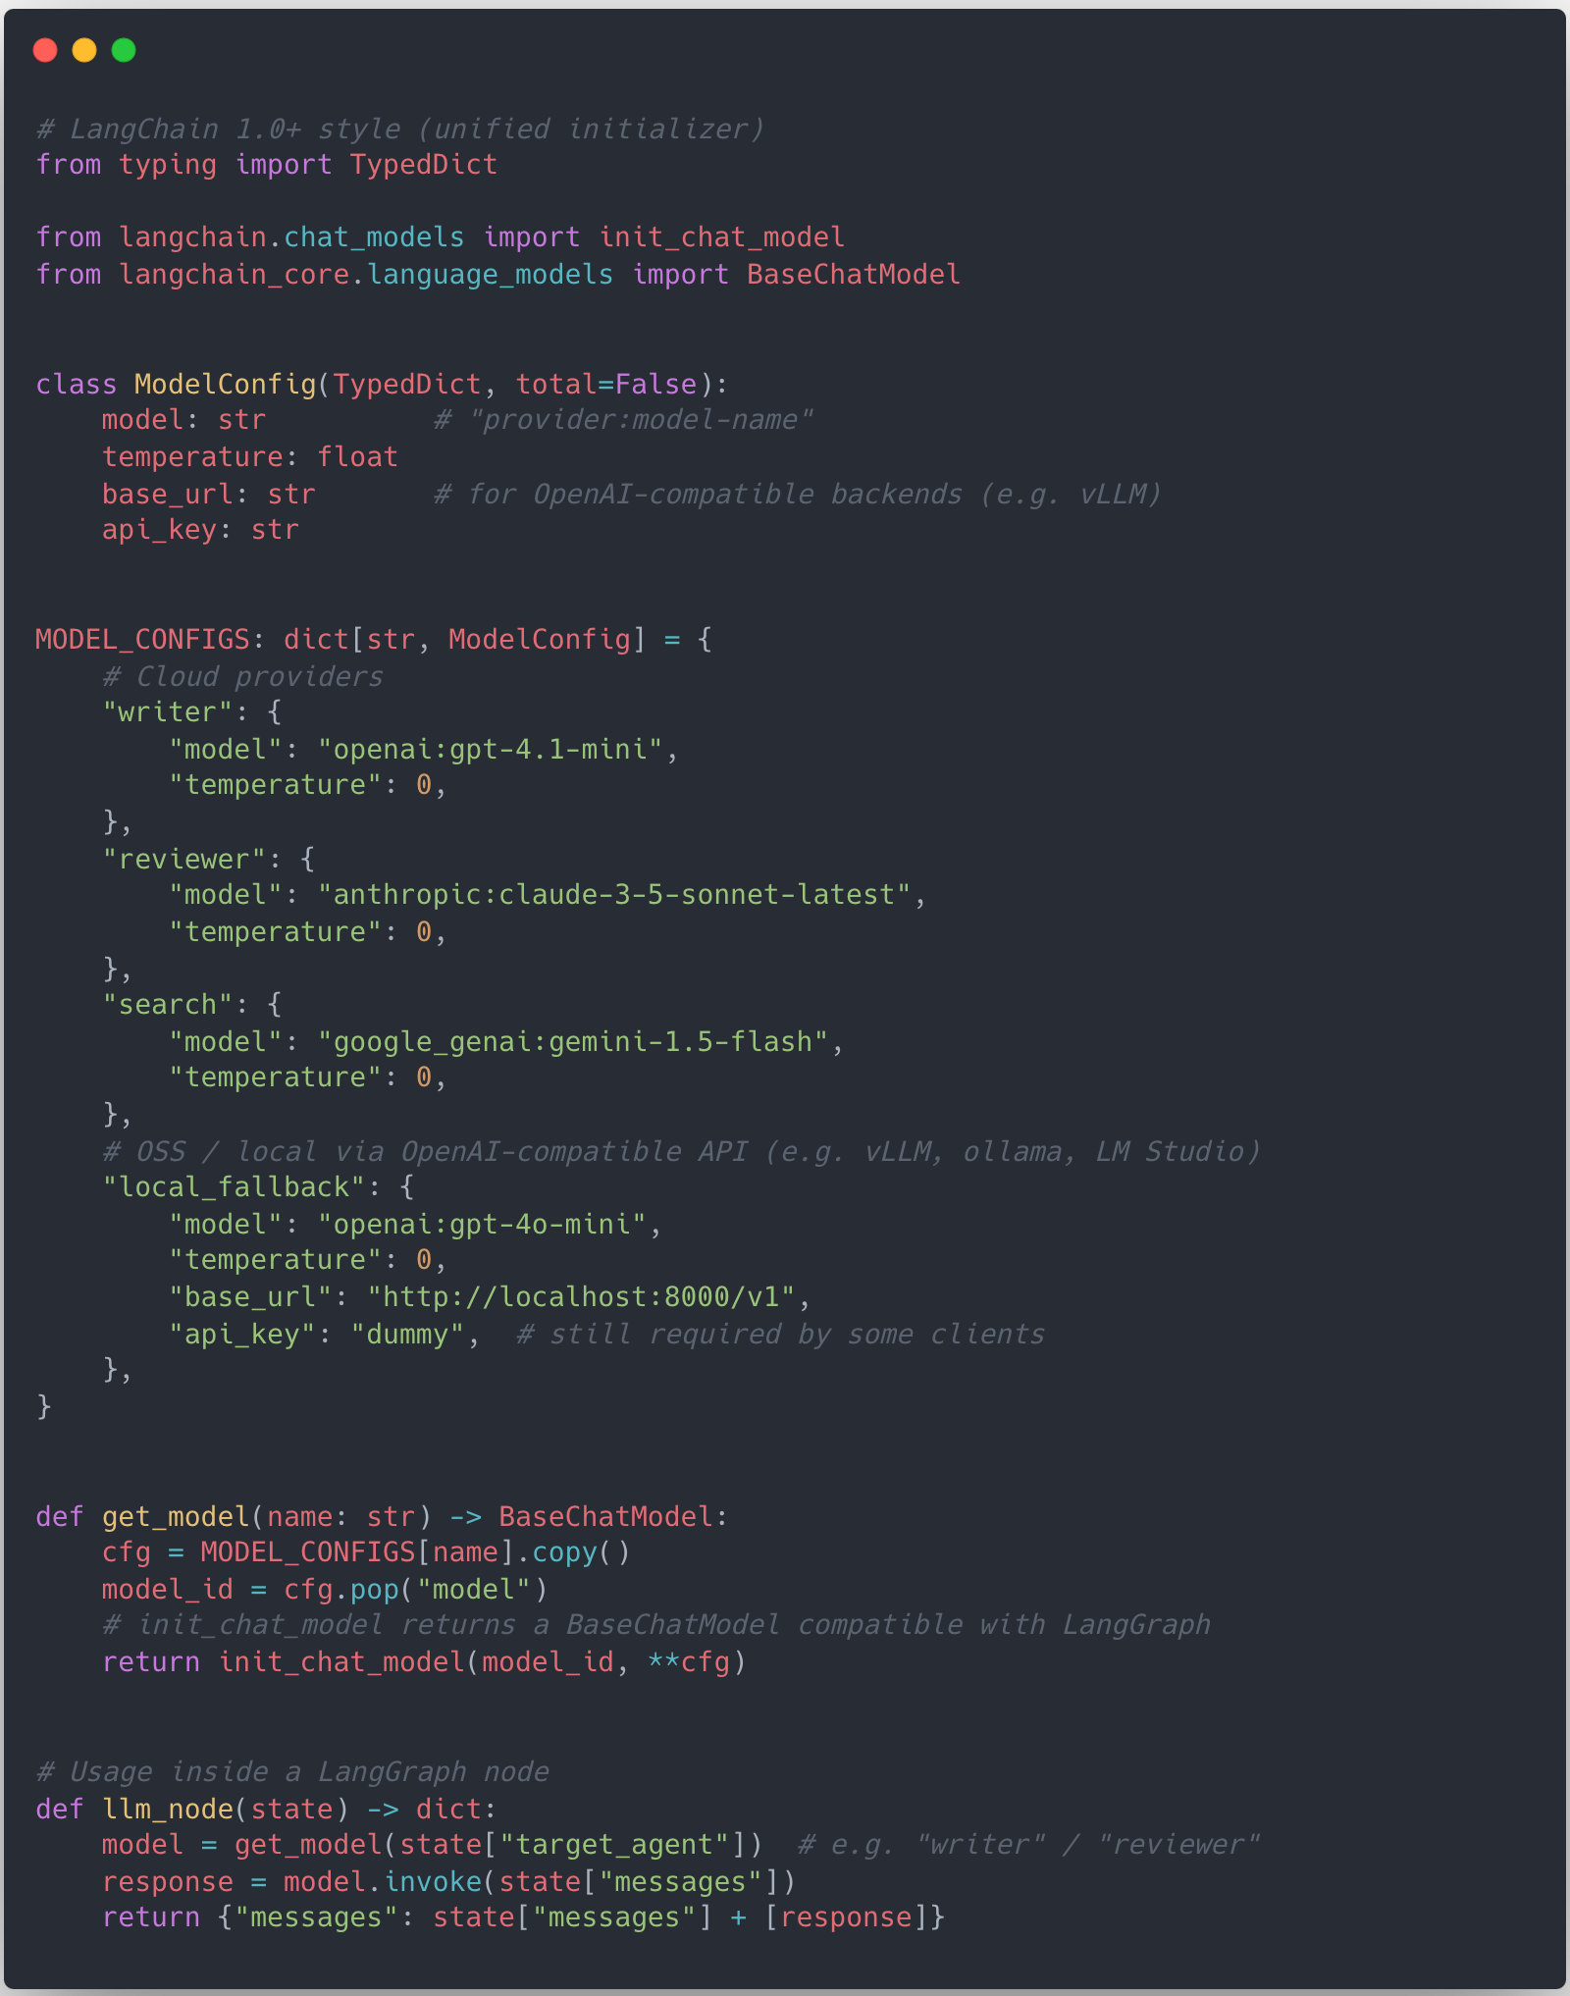
In Code: Unifying Models with BaseChatModel
❺ Strategy for Resilient Agent
LangChain 1.0+
Sample
Overview
LangChain 1.0 init_chat_model gives unified initializer
Early version supported, but officially from 1.0+
Same graph nodes, different backends via config only
Switching providers or moving to vLLM
Update MODEL_CONFIGS

Slide 38
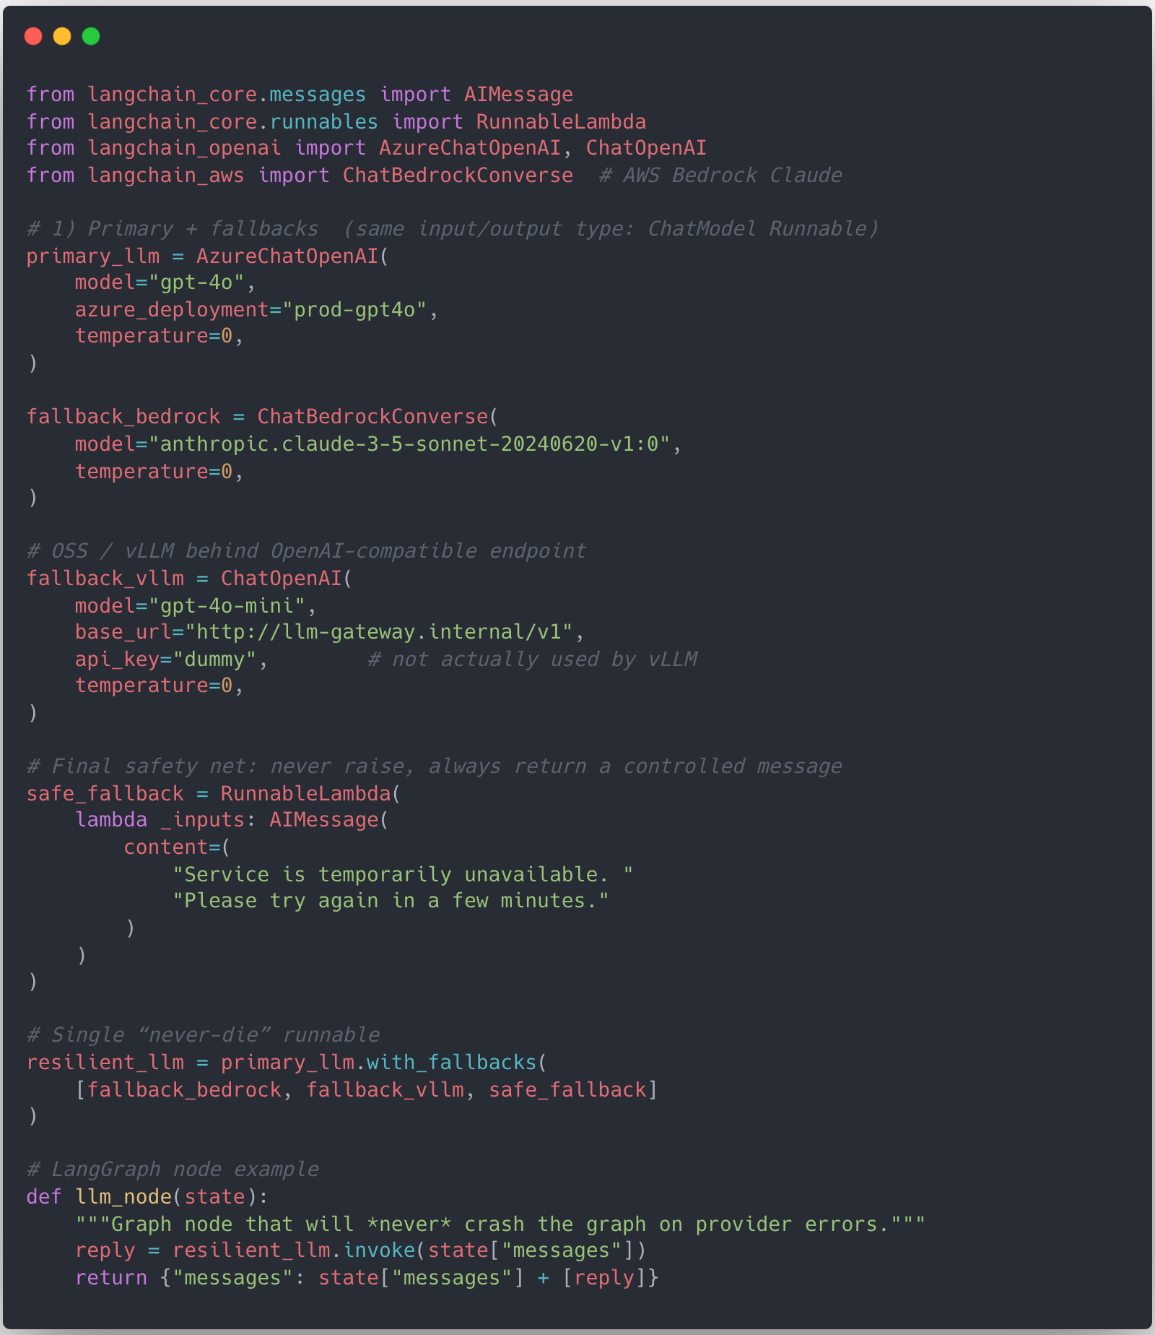
Keeping the graph alive with .with_fallbacks()
❺ Strategy for Resilient Agent
Principle
Never expose raw provider errors to the user
Always return some controlled response
Fallback chain example
Some issues reported .with_fallbacks() seems not properly working when streaming
Sample
Primary: Azure OpenAI
→ on failure
Fallback1: AWS Bedrock Claude
→ on failure
Fallback2: GPT=OSS via vLLM
→ on failure
Final: safe “service unavailable” message

Slide 39
The Stacks of Agent System - ② Context
❺ Strategy for Resilient Agent
Copied

Slide 40
② Context - Everything around the LLM
❺ Strategy for Resilient Agent
Tools
Weather, exchange rates, calculator, …
Custom internal tools
Databases
Vector DBs for retrieval / RAG
Legacy DMBS for transactional data
External APIs
Third-party services
Partner/internal microservices
In LangGraph, Nodes = “when/how to call which tool with which state”

Slide 41
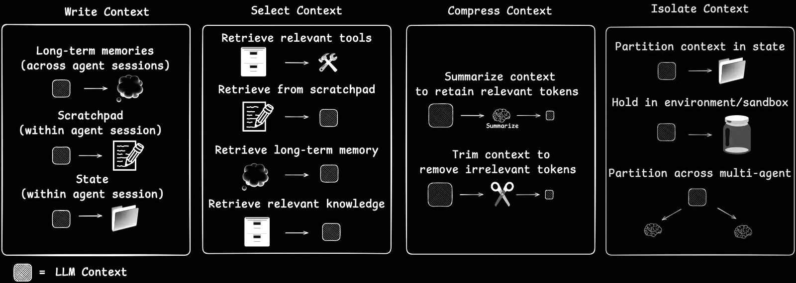
Context Engineering: Feeding LLMs the Right Context
❺ Strategy for Resilient Agent
Agents need carefully chosen context to act effectively.
Sources: https://blog.langchain.com/context-engineering-for-agents/

Slide 42
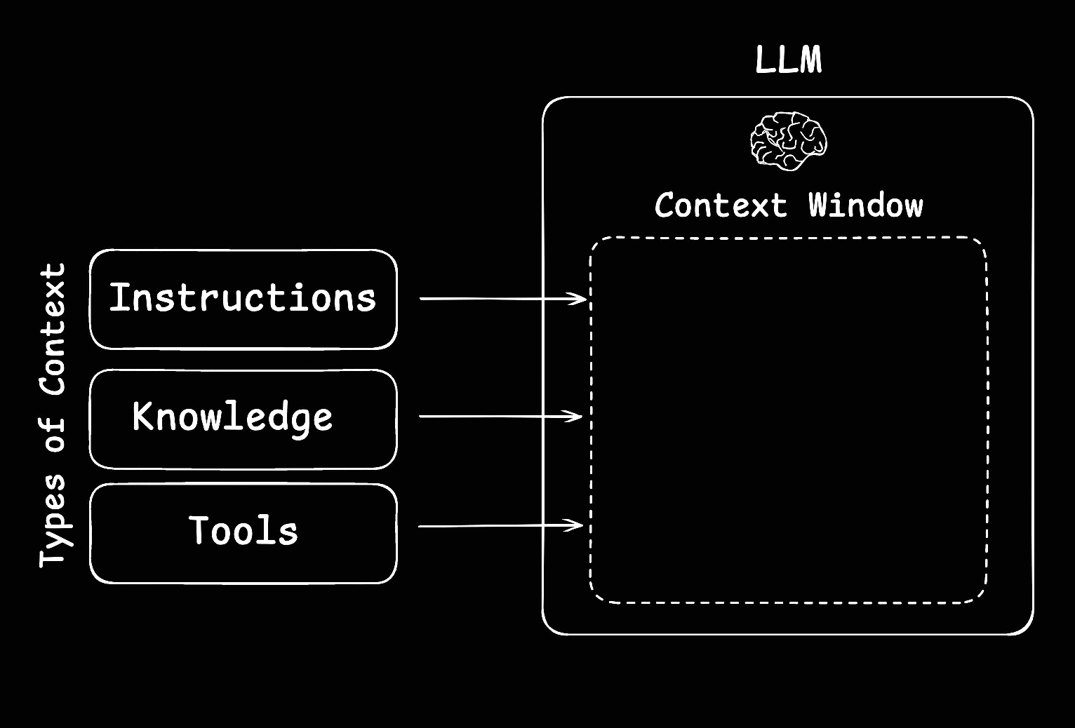
Context Engineering: Feeding LLMs the Right Context
❺ Strategy for Resilient Agent
Context engineering is the art and science of filling an LLM’s limited context window with just the right information at each step.
Sources: https://blog.langchain.com/context-engineering-for-agents/

Slide 43
Context as the Agent’s shield
❺ Strategy for Resilient Agent
Context = not just “extra prompt text”
It’s a defensive layer for agent survival
Pre-context layer: Clean & sanitize input before LLM
Execution context layer: Keep model/tool calls from exploding
Post-context layer: Validate & adapt output for the product
We focus mostly on the pre-context layer

Slide 44
3-Layer Context Middleware (Pre / Exec / Post)
❺ Strategy for Resilient Agent
Layer | Operation
Pre-context layer (before LLM) | Input cleaning & normalization Length control (summaries / trims) PII removal Intent classification / safety filter Context shaping (decide if RAG is needed)
Execution context layer (during calls) | Limit model call count LImit tool calls & recursion Timeouts / circuit breakers Fallback model routing HITL intercepts
Post-context layer (after LLM) | Output normalization Safety filtering Quality threshold → redirect / degrade Summarized or downgraded responses

Slide 45
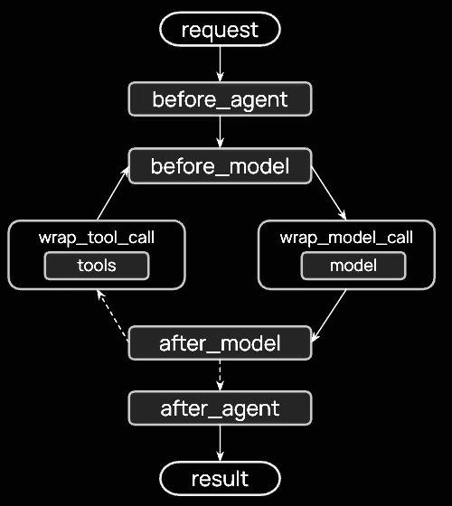
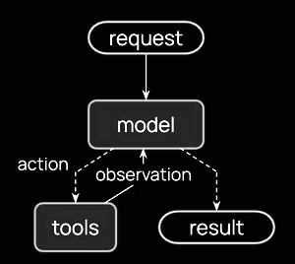
LangChain’s Agent Loop
❺ Strategy for Resilient Agent
Middleware provides to handle pre, exec, post context layers seamlessly
Sources: https://docs.langchain.com/oss/python/langchain/middleware/overview#the-agent-loop

Slide 46
Pre-Context I: Shrink the input, Save the run
❺ Strategy for Resilient Agent
Problem
Long chat history + raw tool/DB dumps → token explosion
Context length errors and failed runs
Strategy in LangGraph
Use pre_model_hook (now middleware in 1.0)
Insert summary / trim nodes before LLM calls
Preserve the minimal context needed for the current decision
Token limit errors are handled at the system level, not left to chance

Slide 47
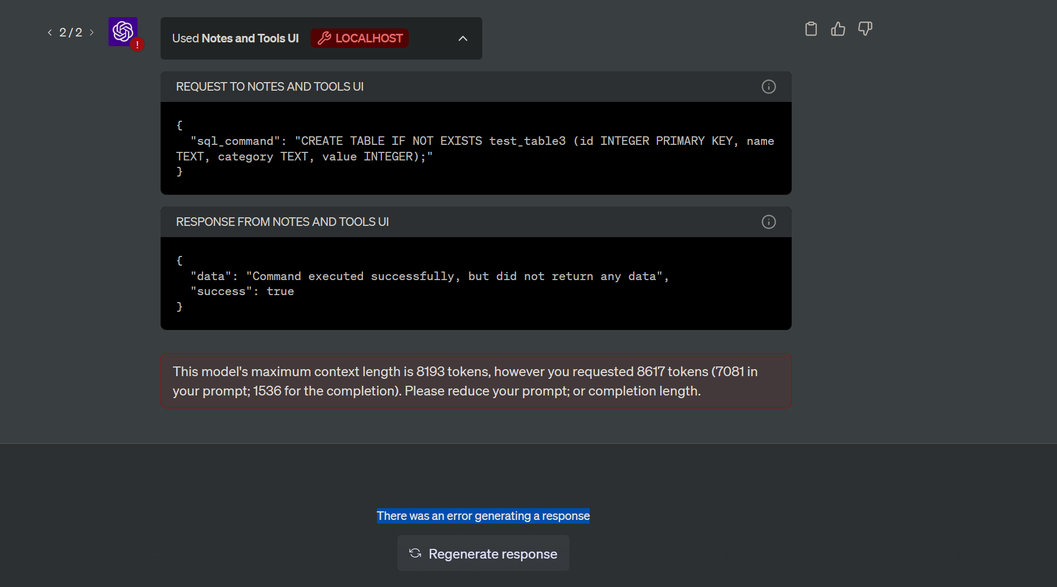
Pre-Context I: Shrink the input, Save the run
❺ Strategy for Resilient Agent
Example
Sources: https://community.openai.com/t/this-models-maximum-context-length-is-8193-tokens-does-not-make-sense/288627

Slide 48
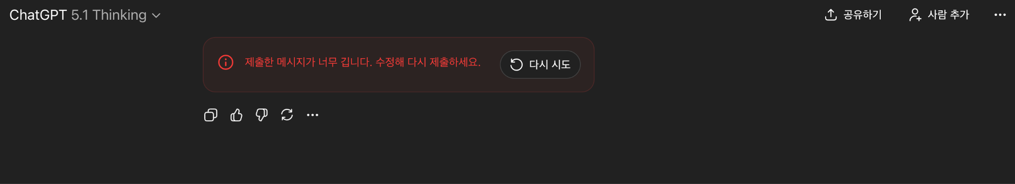
Pre-Context I: Shrink the input, Save the run
❺ Strategy for Resilient Agent
Example

Slide 49
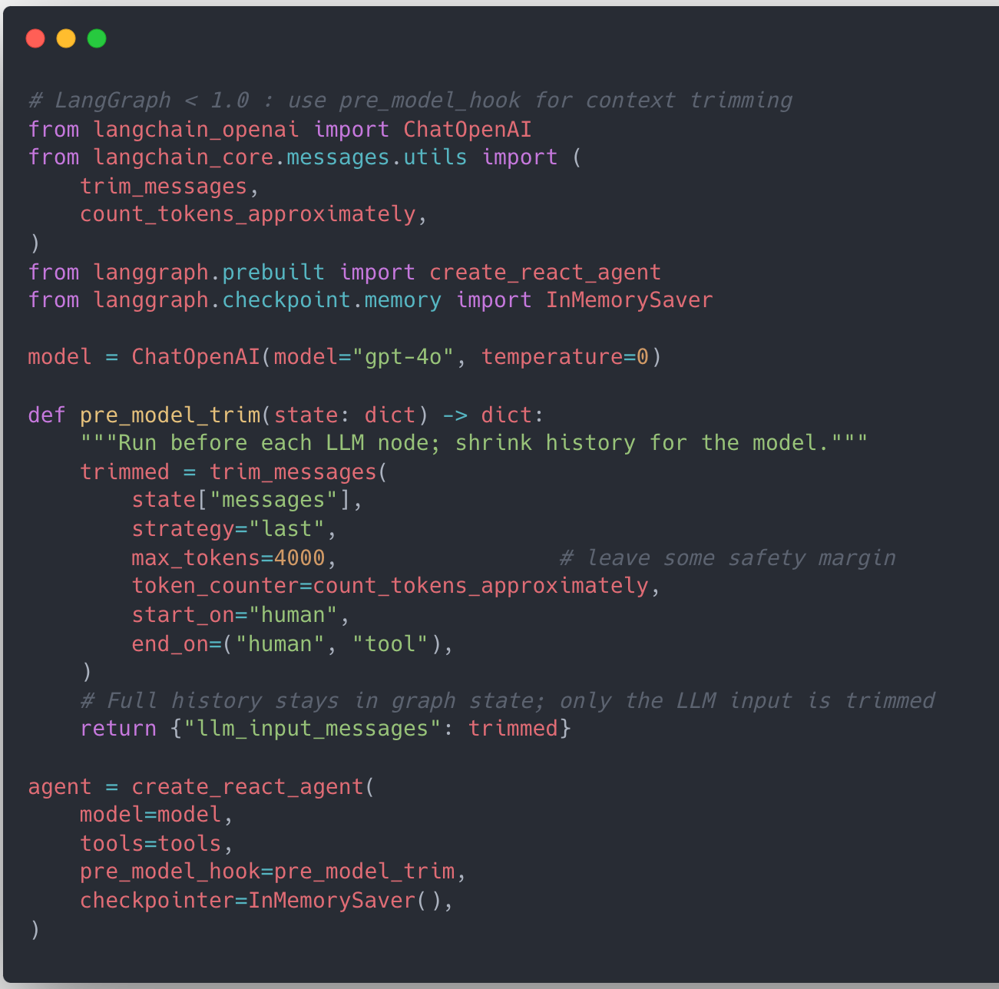
Pre-Context I: Shrink the input, Save the run
❺ Strategy for Resilient Agent
LangChain < 1.0
Sample
Overview
Use pre_model_hook to intercept every LLM call
Call trim_messages before the model sees the history
Send trimmed messages via llm_input_messages

Slide 50
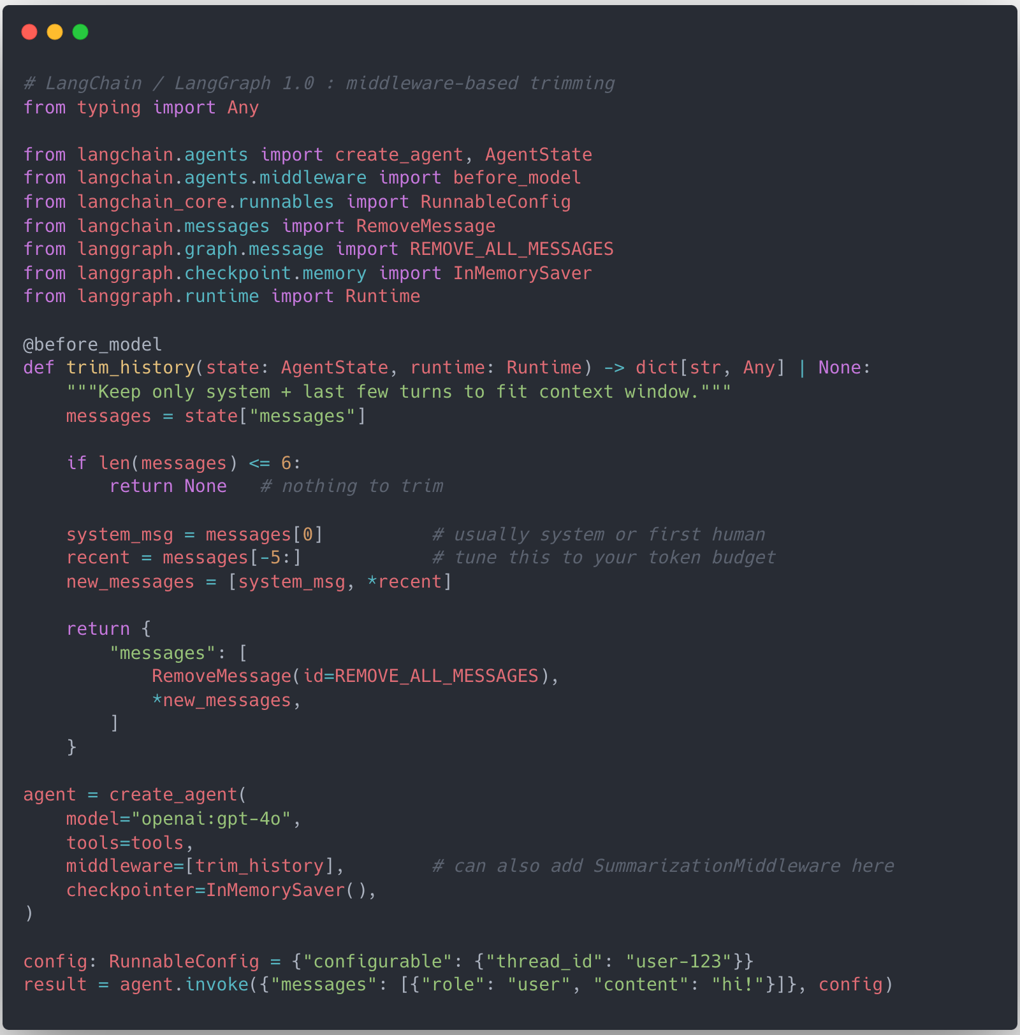
Pre-Context I: Shrink the input, Save the run
❺ Strategy for Resilient Agent
LangChain 1.0+
Sample
Overview
pre_model_hook ⇒ before_model middleware
Middleware operates on shared AgentState.messages
Same trim logic can be reused across many agents

Slide 51
Pre-Context II: Mask PII at the door, Not after the fact
❺ Strategy for Resilient Agent
PII examples
Phone numbers, credit card numbers
Email addresses, national IDs
Design choice
Strip / mask PII before LLM sees anything
Implement as a dedicated PII-masking node at the graph entry
This is about security & compliance, not prompts
Post-incident, we can confidently say: “No raw PII ever entered the LLM context”

Slide 52
Pre-Context III: RAG only when needed
❺ Strategy for Resilient Agent
Native RAG pattern
Query → retrieve docs → send all docs + query to LLM
Problems in production
Unnecessary retrieval cost for simple queries
Irrelevant docs polluting the prompt
Higher latency & token usage
Context shaping layer
Pre-LLM router decides: direct LLM vs RAG, which domain retriever to use, how many docs
Based on query type, intent, and risk

Slide 53
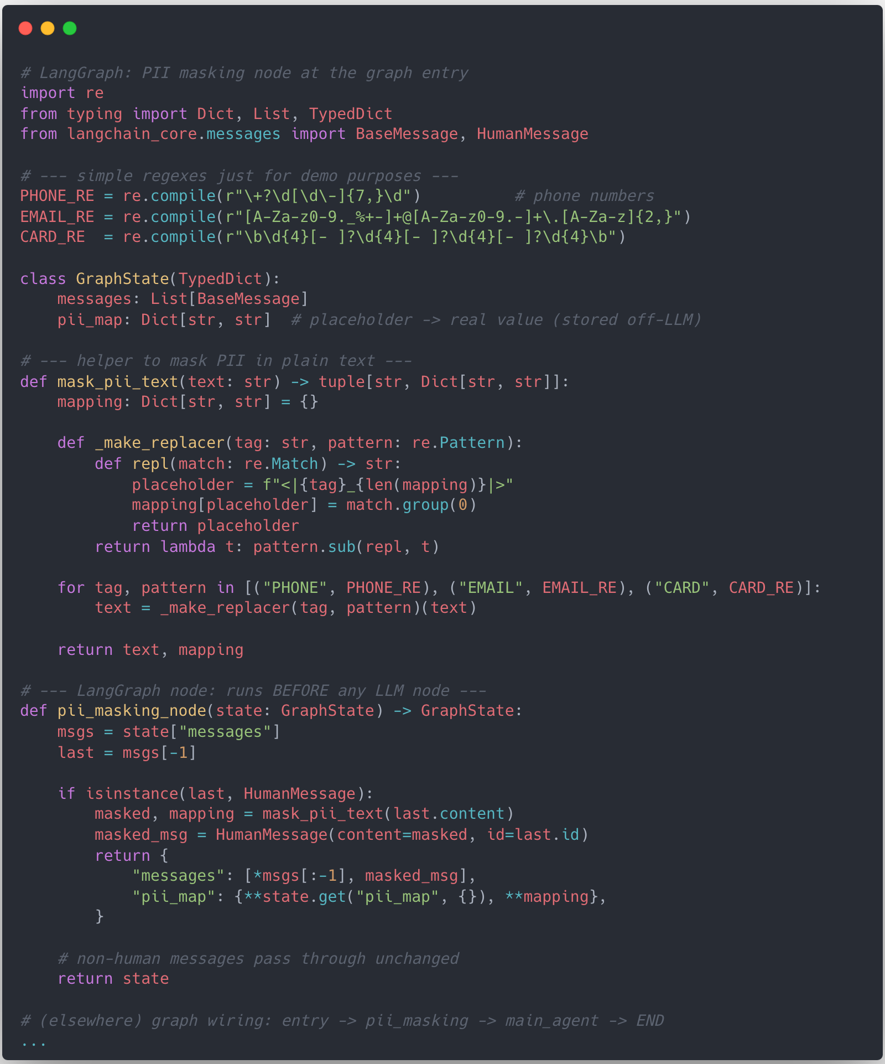
Pre-Context II: Mask PII at the door, Not after the fact
❺ Strategy for Resilient Agent
Sample
In practice
Regex + validators in a LangGraph node
Replace with place holders (<|PHONE|>, <|CARD|>, …)
Optional mapping table stored on a secure side-channel if needed

Slide 54
The Stacks of Agent System - ③ Agent Orchestration
❺ Strategy for Resilient Agent
Copied

Slide 55
③ Agent Orchestration - Where LangGraph shines
❺ Strategy for Resilient Agent
Prompts
System / task prompts per agent
Source code
Routing logic, transformations, validation, …
State
Conversation state, intermediate results
Authorization / policies
Who can trigger what, with which tools
This is modeled as a LangGraph:
Nodes = agents / tools / control logic
Edges = transitions based on state & outcomes

Slide 56
How LangGraph keeps agents alive at runtime
❺ Strategy for Resilient Agent
Agent-level survival features in LangGraph
Recursion limit → stop infinite loops
Errors as state, not exceptions
Multi-level timeouts
Interrupts / breakpoints
Combined goal is to protect infinite loop and infinite waiting

Slide 57
Recursion Limit: Cutting infinite loops with recursion limits
❺ Strategy for Resilient Agent
Common failure mode: infinite loops
Agent A → Agent B → Agent A → …
Misplanned “try again” loops that never end
LangGraph’s help
Pregel-style engine with recursion limit
Stop execution after N graph steps / hops
LLM can still make bad plans
But the runtime prevents bad plans from killing the system

Slide 58
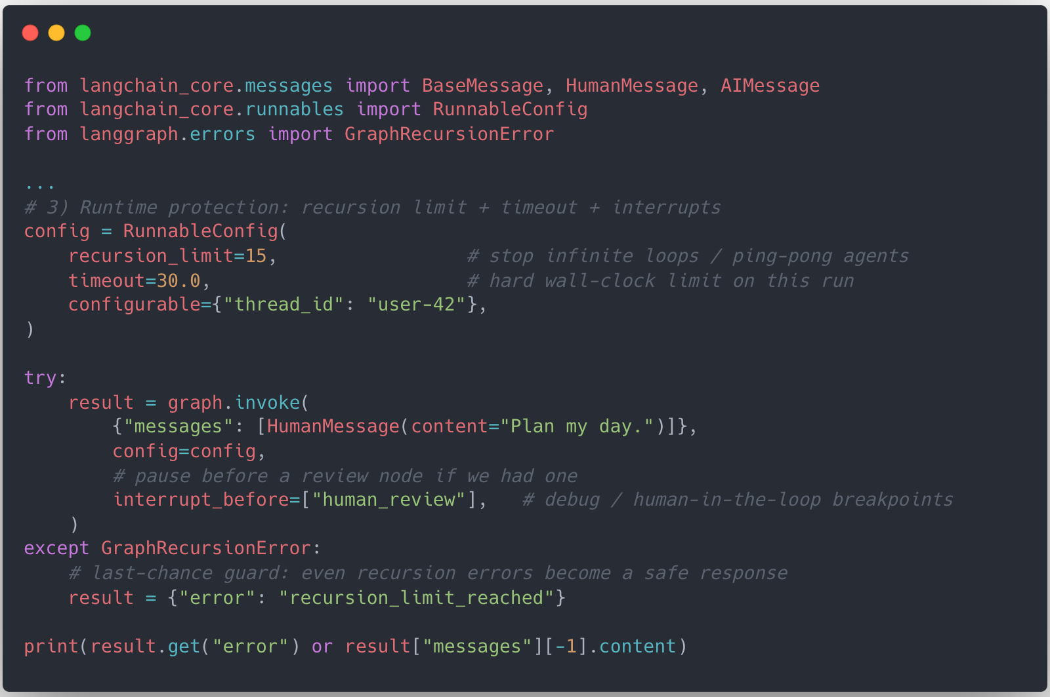
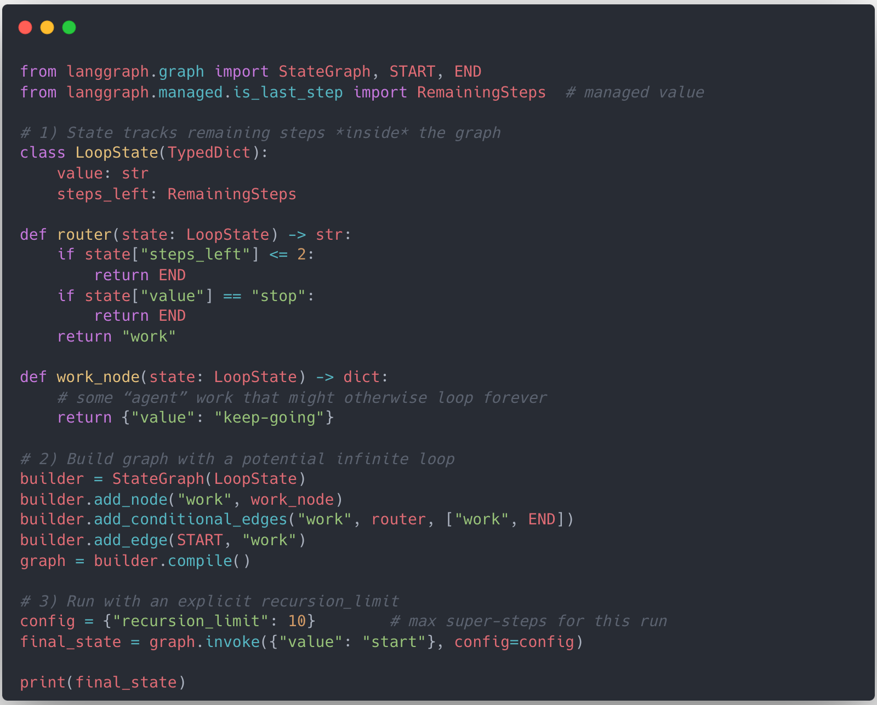
Recursion Limit: Cutting infinite loops with recursion limits
❺ Strategy for Resilient Agent
recursion_limit
+ timeout
+ interrupt
recursion_limit
+ RemainingSteps
Sample
Sample

Slide 59
Errors as State, Not Exceptions
❺ Strategy for Resilient Agent
Traditional view: Error = throw exception → 500
Our graph view: Error = part of state
State schema example:
status: “ok” | “error” | “degraded”
error: error code / message
attempts: number of retries
Errors are handled inside the graph, instead of killing the entire service

Slide 60
Timeouts: Don’t let one slow node freeze the graph
❺ Strategy for Resilient Agent
Multi-level timeouts
Model call timeout
Tool call timeout
Overall graph execution timeout
Per-node timeouts, e.g.
Retrieval + justification node: up to 5s
Simple reformatting node: abort after 2s, then fallback
On timeout
Route to summarized / partial answer node, user-facing apology + background queue node
Users rarely see “I can’t find anything” / “no result” non-answers

Slide 61
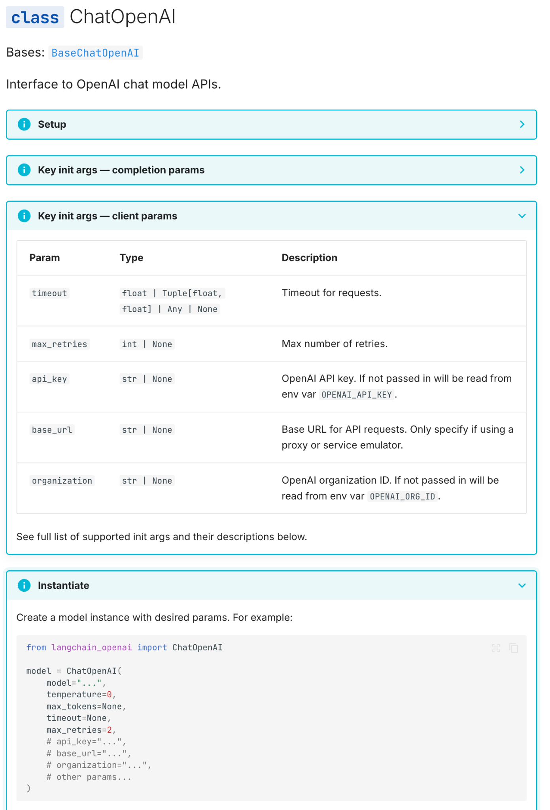
Wait… We were already using safety features
❺ Strategy for Resilient Agent
safety feature were used by default
Built-in features
Default retries (max_retries)
Exponential backoff
Fail-safes model calls
…

Slide 62
④ Ops & Assets - keeping agents alive in prod
❺ Strategy for Resilient Agent
Ops
Deployment, CI/CD
Monitoring, logging, alerting
Cost & quota control
Assets
Config, secrets
Prompt & model versions
Policy definitions
LangGraph’s role here
Exposes traces, checkpoints, execution logs
Makes the workflow observable by external Ops tooling

Slide 63
The Stacks of Agent System - ④ Observability
❺ Strategy for Resilient Agent
Copied

Slide 64
④ Observability: You can’t fix what you can’t see
❺ Strategy for Resilient Agent
No matter what we do, some agents will fail
“If you don’t know where agents die, you can’t make them not die.”
Beyond “keep it alive” we need to know
Why did the agent fail?
Where is it slow?
Which parts are bottlenecks?
Code & intuition are not enough.
We need traces, not guesses

Slide 65
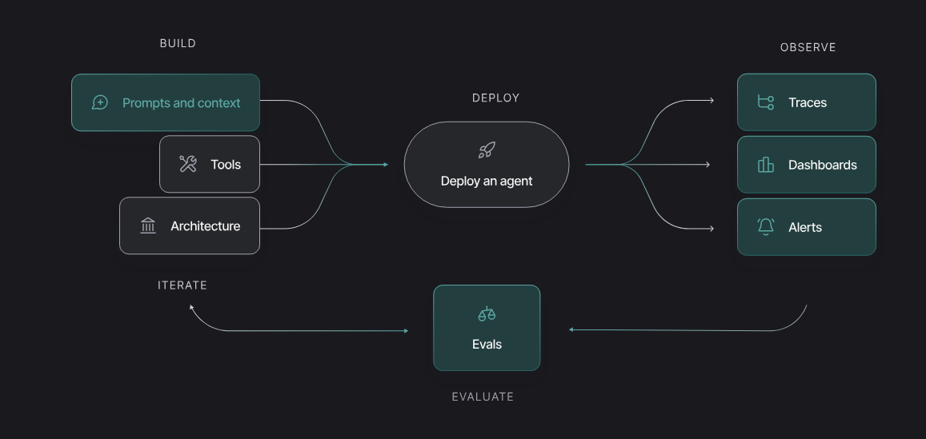
LangSmith Observability
❺ Strategy for Resilient Agent
Sources: https://docs.langchain.com/langsmith/home

Slide 66
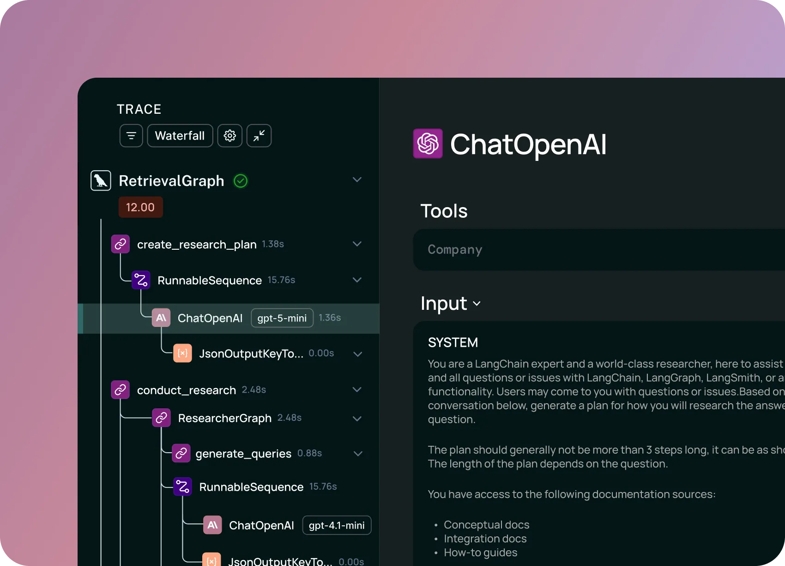
LangSmith Observability
❺ Strategy for Resilient Agent
Sources: https://docs.langchain.com/langsmith/home

Slide 67
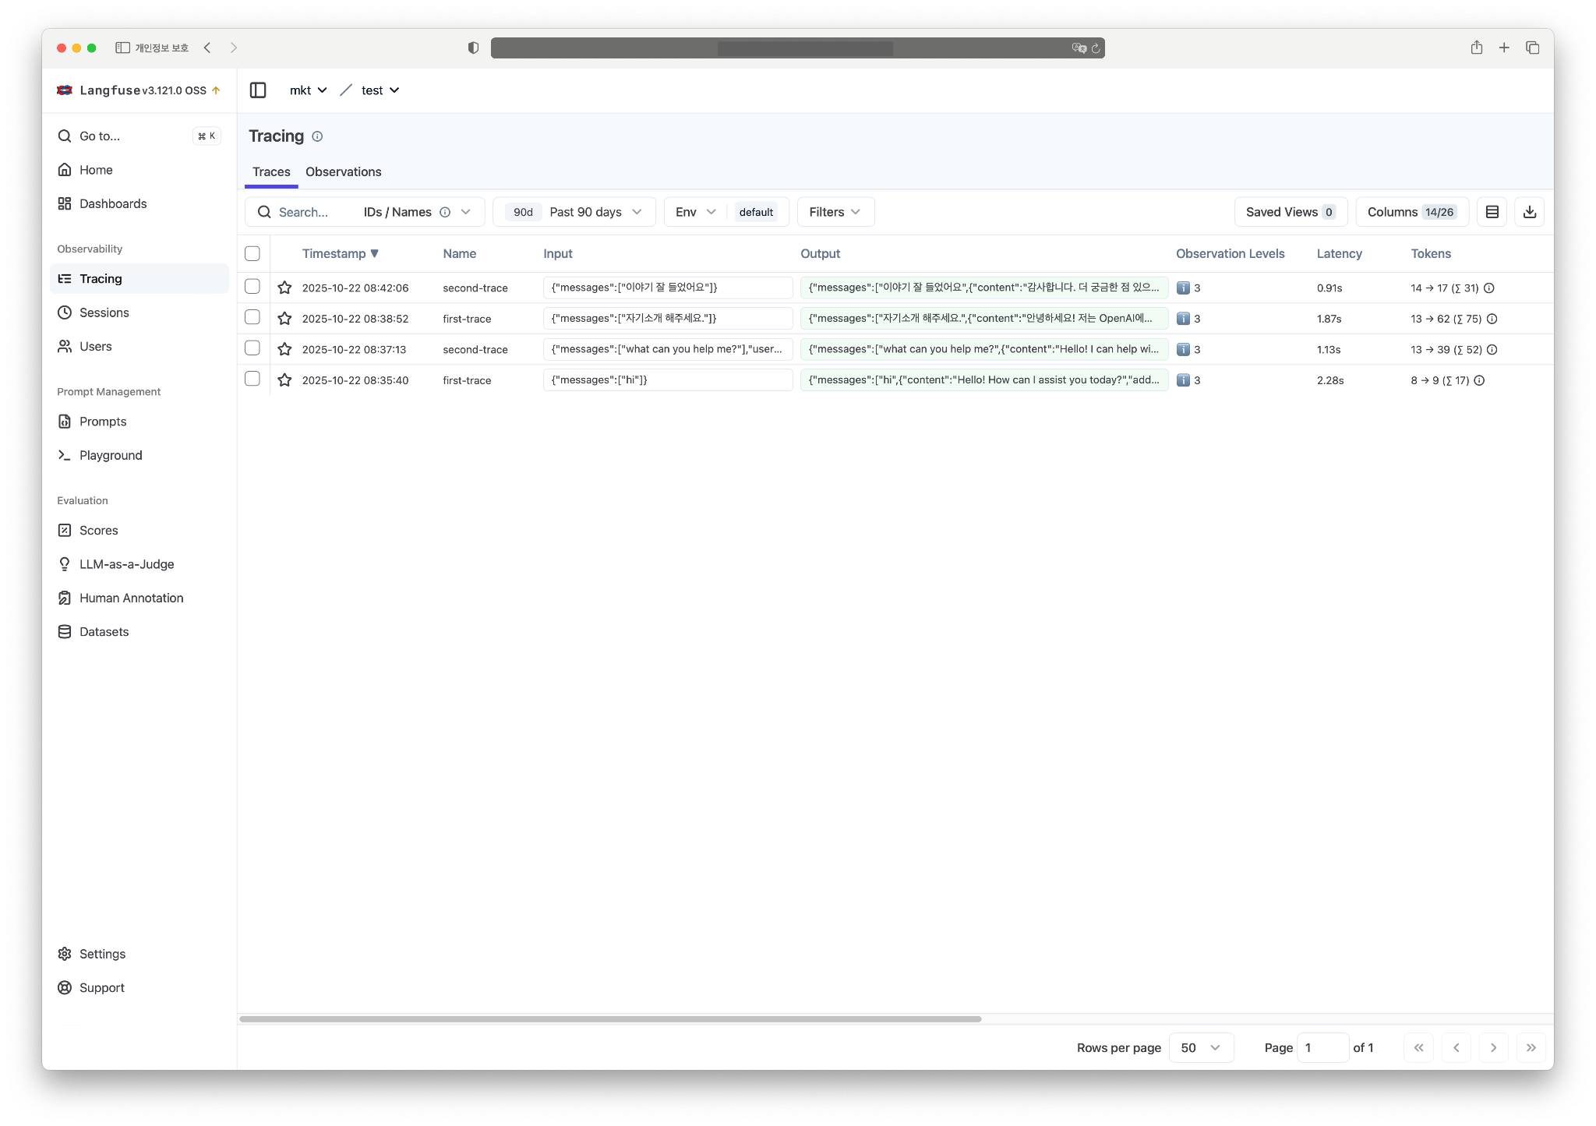
🪢 Langfuse: Alternative to LangSmith
❺ Strategy for Resilient Agent

Slide 68
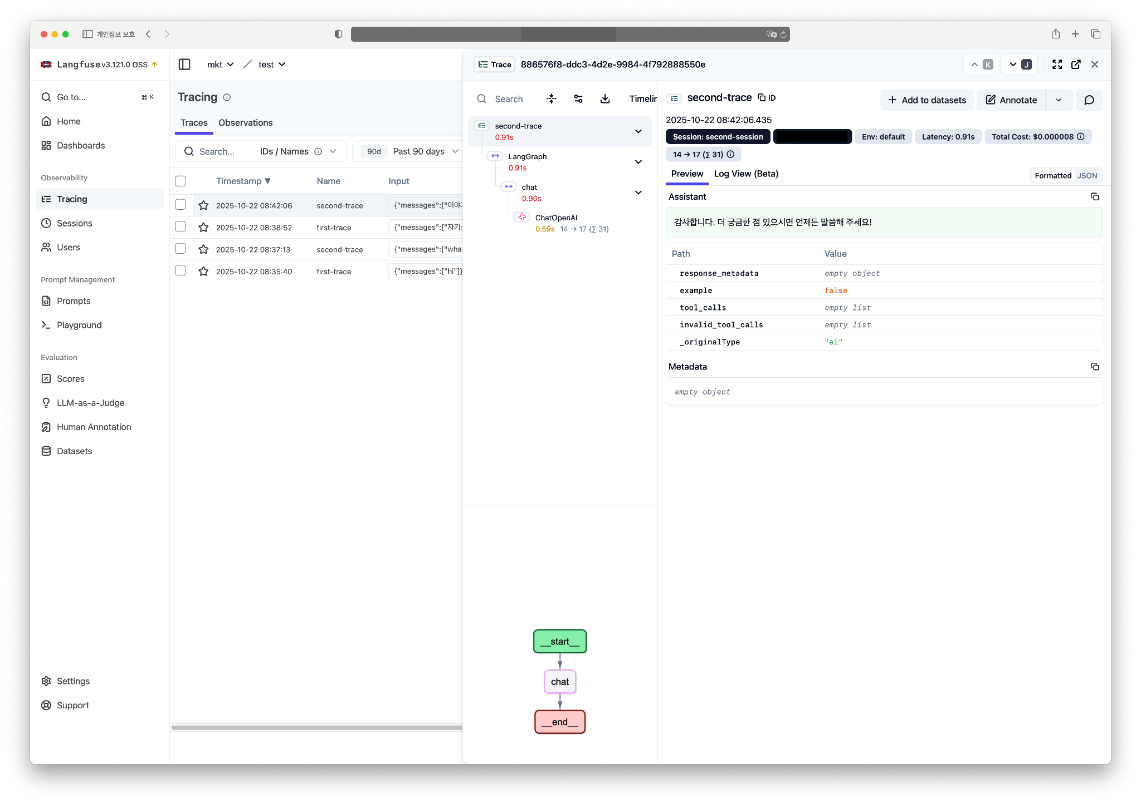
🪢 Langfuse: Alternative to LangSmith
❺ Strategy for Resilient Agent

Slide 69
What we can see LangGraph x Langsmith / Langfuse
❺ Strategy for Resilient Agent
With LangSmith / Langfuse integration
Trace every LangGraph node execution
Inspec per-node latency, error rate, retry count
Identify the most failing nodes, the slowest nodes where fallbacks are triggered most often
This turns graph into a measurable workflow, not a black box

Slide 70
Observability as the backbone of “Die Hard” agents
❺ Strategy for Resilient Agent
Observability is a requirement
With LangGraph + LangSmith/Langfuse, we can iteratively
Locate failures precisely (by node / edge)
Quantify slowness & bottlenecks
Validate whether retries, fallbacks, timeouts
End goal
Not “agents that never fail”
But “agents that, when they do fail, are easy to see, debug, and harden in the next iteration

Slide 71


Slide 72
What we really gained: A small-team strategy
❻ Conclusion
Our three strategic pillars
1️⃣ Focus on what the agent should do
2️⃣ Reduce run-time cost with precise control
3️⃣ Design products that don’t stop when things break
Failures are local, not fatal. The system can recover and improve
Timeouts, fallbacks, error routing
Traces to fix root causes in the next iteration
→ Resilience = recoverable architecture, not perfection

Slide 73
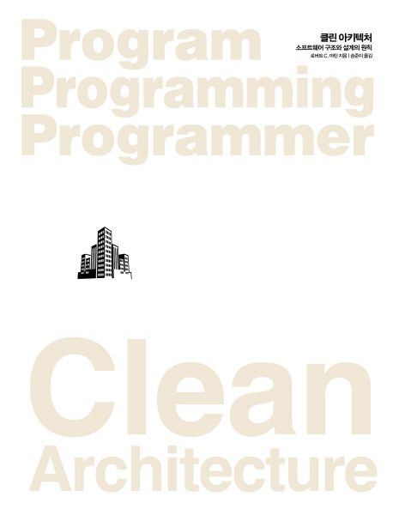
Don’t fall in love with frameworks
❻ Conclusion
Clean Architecture says: “Don’t fail in love with frameworks.”
LangGraph is not “the answer” → It’s one concrete way to implement general principles
The portable lessons:
Design for recovery, not perfection
Treat context as a defensive layer
Keep LLMs behind stable interfaces
Make failures observable and routable
Whatever framework you choose next
These principles still help you build resilient, “hard-to-kill” agents

Slide 74
Thank you
for your time and consideration

